Slide 1

Knowledge Hub
Session 2
18 June 2025

Slide 2

Introducing Data Standards for Human Rights Documentation
Sam Ng
Sinar Project is a civic tech initiative using open technology, open data and policy analysis to systematically make important information public and more accessible to the Malaysian people.
Knowledge Management & Community Officer
Notes:
Knowledge Management & Community Officer
Sinar Project is a civic tech initiative using open technology, open data and policy analysis to systematically make important information public and more accessible to the Malaysian people.
ONE of our projects from the 3 Spheres convening is the Enabling Technology portal of which Knowledge Hub site is part of
We aim to enable civil society. researchers to better understand digital issues, by having this portal to share knowledge resources such as events in the space which includes activities, events, collection of information (definitions) and etc to bridge traditional organisations to the digital spaces.
Initiate will help us with curation & organising the content resources and We will also engage a designer soon to make it easier to navigate.
As part of the Spheres convening, Sinar also has a Fellowship program as part of capacity building for legal-tech & tech fellow to get ito civil society/ngo.

Slide 3
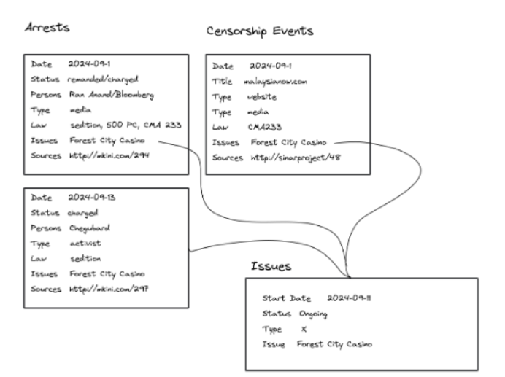
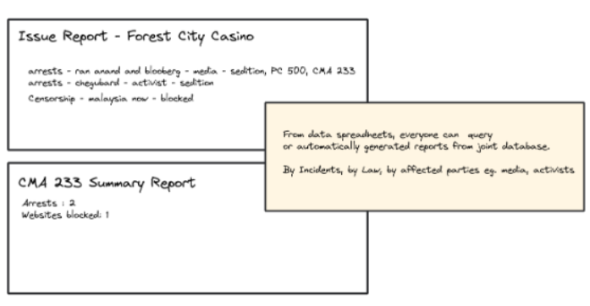
What’s the story?
Sinar Project
Excel/Google Sheets
Notes:
In the effort to not make it too dry & technical - let me tell a story about 3 organisatoin in the CSO/NGO space
A few organisations got together last September to discuss joint monitoring
ORG1 & ORG2 - death penalty, arresets, censorship, cma, etc
Sinar - censorship reports online
Overwhelming amount of incidents and issues to track around human rights and freedom of association and expression
Some overlaps in collection of data for tracking and reporting. Reports to be written by members often cover multiple sources of data such as investigations and arrests, online censorship incidents such as blocking, takedown requests, media freedoms and policy positions
Example for a specific issue around “Royalty meeting for online gambling”
Police investigations and charges on journalists
Take down notices on social media
Possibly related blocking of websites
Statements by politicians, royalty and enforcement officials to not comment
Each sources of data can be quite detailed, to also generate specific statistics for analysis eg. for arrests and investigations, would include status (investigated, remanded, charged), laws used, and type persons arrested (journalists, politicians, members of public, human rights activists and so on.
Initial scope is to trial one or two online sheets for tracking; i) arrests/investigations and ii) censorship events) and an issue/topic spreadsheet with sample automatically generated reports.
Each data sheet would have an owner who is monitoring and maintaining that sheet, while others can contribute.
If initial trial works, then additional data sheets for collaborative tracking
Good documentation for columns, labels also was highlighted if this goes ahead to make it easy for onboarding new collaborators on data entry and maintenance
Google Sheets - Feels abit hard to manage but is common

Slide 4
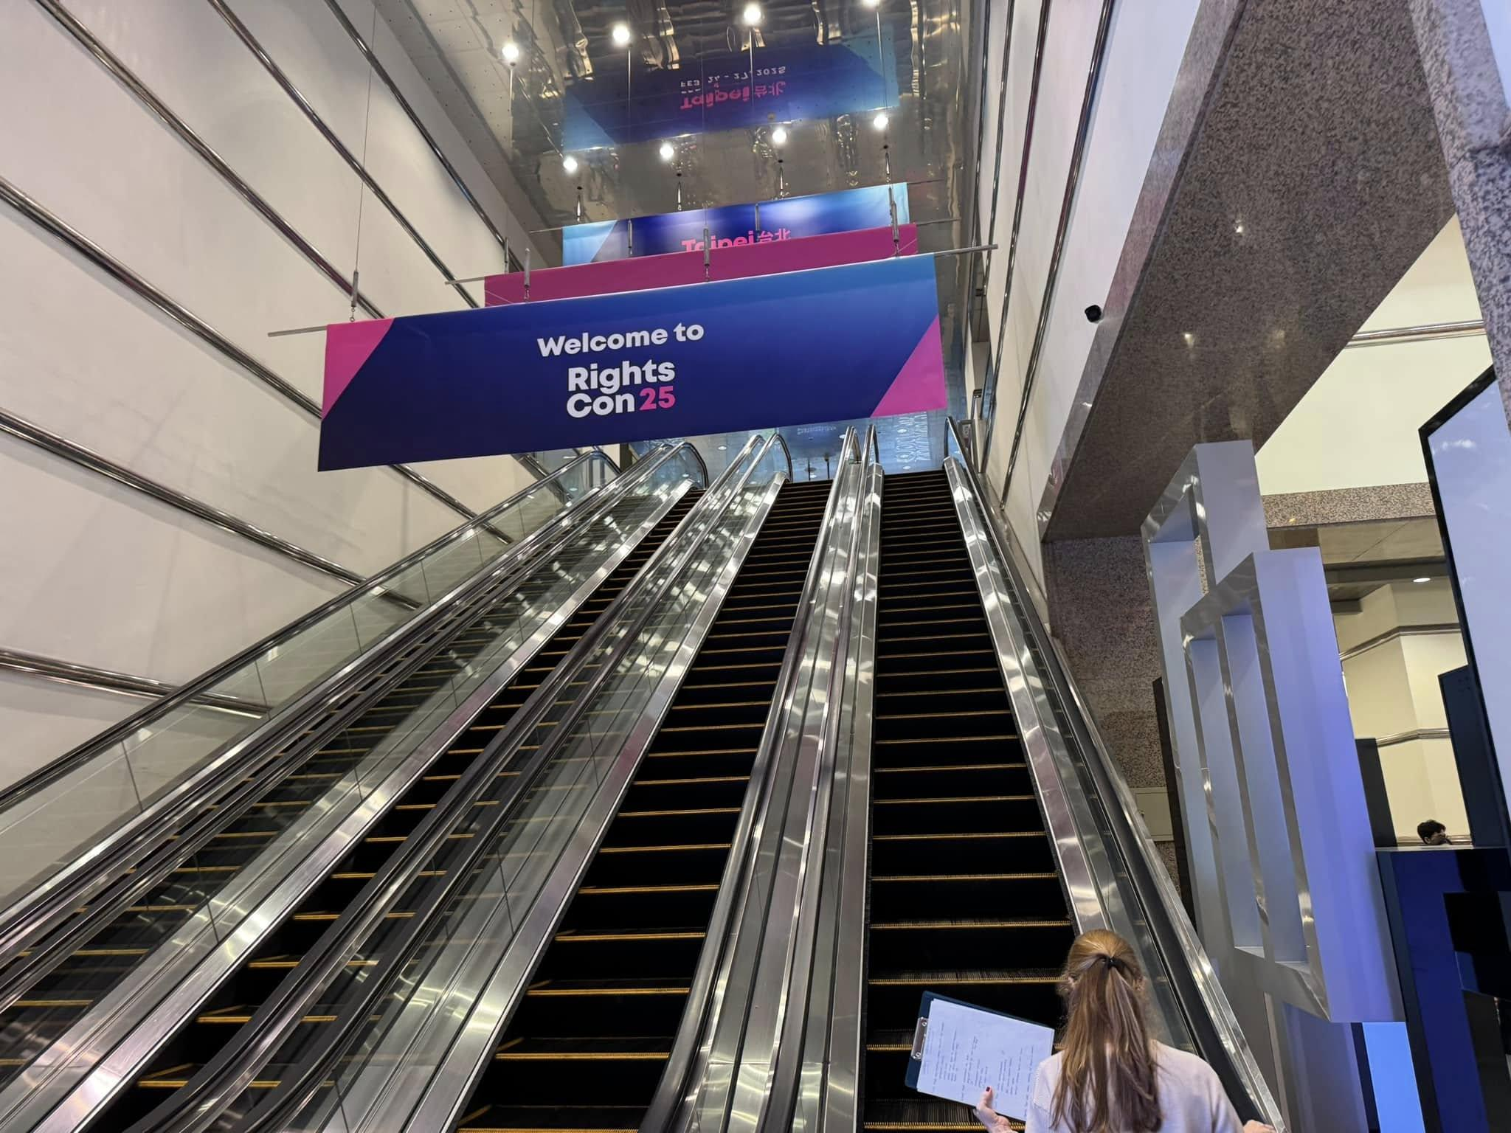
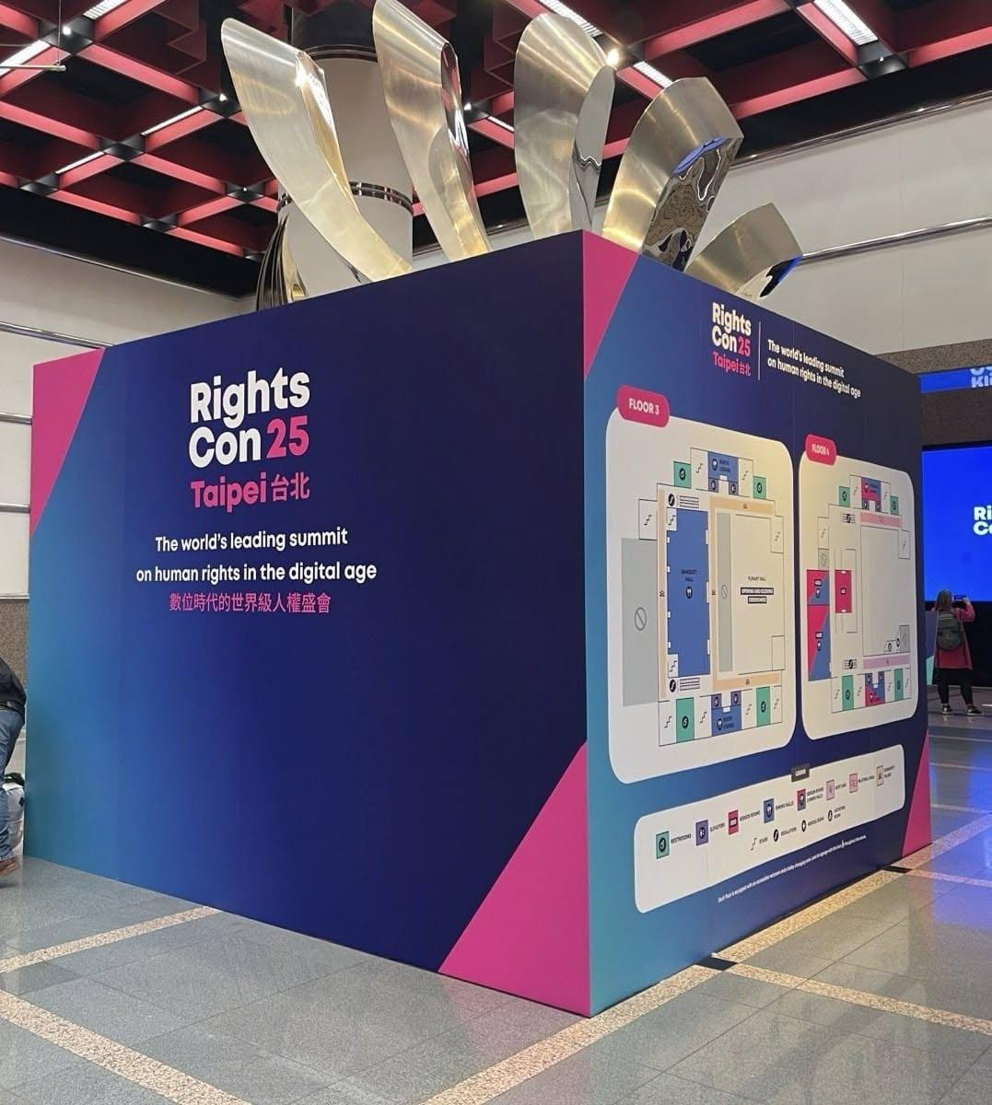


Rightscon Taipei (Feb)
Notes:
Booth by Huridocs -resource for monitoring human rights documentation
Lightning talk on Bayanat - Open Source Human Rights (documentation) Data Management platform

Slide 5

What’s the story?
CAMEO .
DATA STANDARDS allow different organisations to collaborate together by having a shared language
Notes:
Came back from RightsCon, Khairil shared about “GDELT” -a Google Jigsaw project to consider & GDELT CAMEO wrt Category StandardsT
DATA STANDARDS allow different organisations to collaborate together by having a shared language

Slide 6

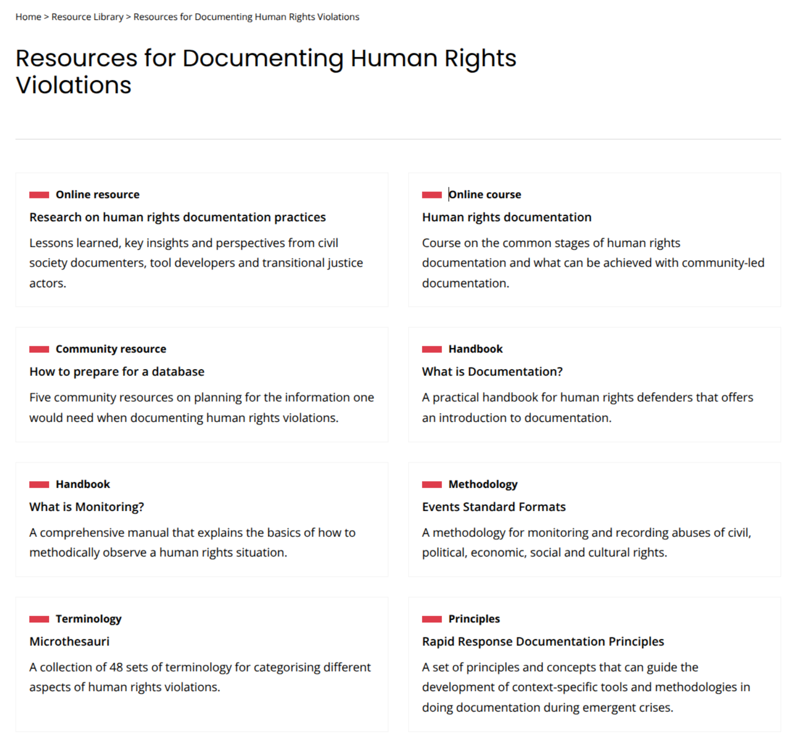
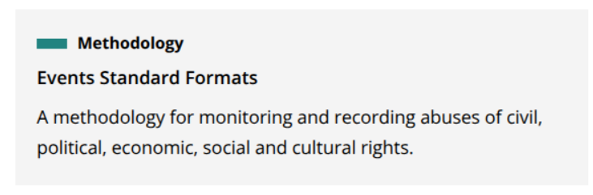

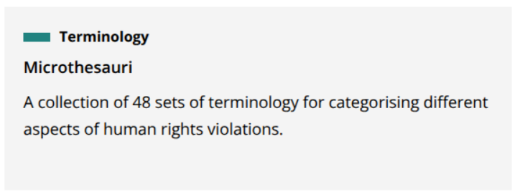
Huridocs?
https://huridocs.org/resource-library/monitoring-and-documenting-human-rights-violations/
Notes:
The huridocs booth was more for their software tool, but I did go through their resource page and found this interesting and relevant.

Slide 7
Huridocs
History of HURIDOCS (Human Rights Information and Documentation Systems)
Org founded in 1970s
Huridocs applied info science(methodology) in the 80s, and developed into Event Standard Format in the 90s.
Event Standard Format was used as the base for software program called Evsys (1993)
2009 - OpenEvsys, an open-source tool for documenting human rights violations based on the Events Standards Formats. 2013 - Casebox - case management software.
Specifically tailored to documenting nuances of
human rights violations,
including the legal frameworks
Notes:
HURIDOCS (Human Rights Information and Documentation Systems) launched at a time when computers weren’t widespread and human rights defenders struggled to efficiently and effectively organise their information.
Framework for Documenting Human Rights
Specifically tailored to the nuances of human rights violations, including the legal frameworks
Can be adapted for tech abuse

Slide 8
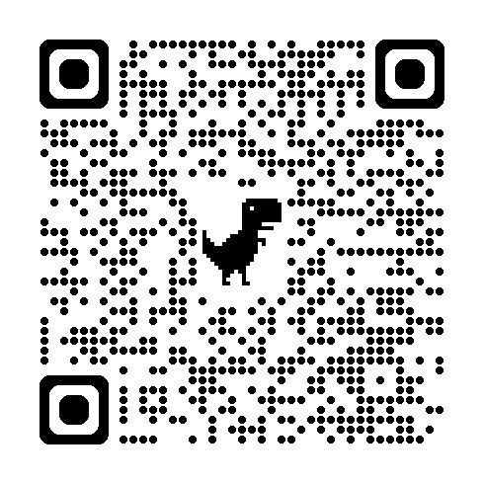
Huridocs
Event Standard Format (methodology)
Microthesauri (vocabulary)
Streamlining Documentation & Analysis
Controlled vocabularies or standardised lists of terms
How to Get Started
Categories available as Spreadsheets
Translated into 9 other languages
Notes:
Framework for Documenting Human Rights
Specifically tailored to the nuances of human rights violations, including the legal frameworks
Can be adapted for tech abuse

Slide 9
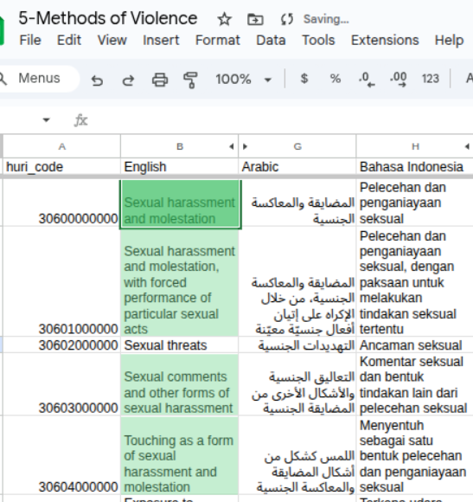
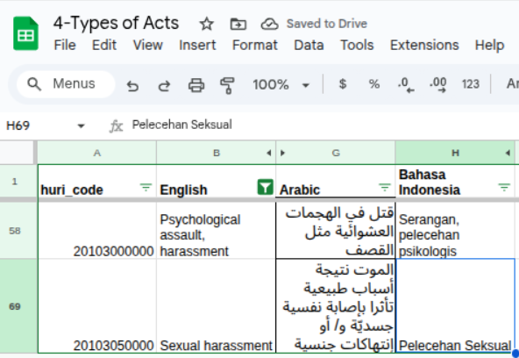

Huridocs
Example: Online Harrassment case
Microthesauri (vocabulary)
4 - Types of Acts
5 - Methods of Violence

Slide 10
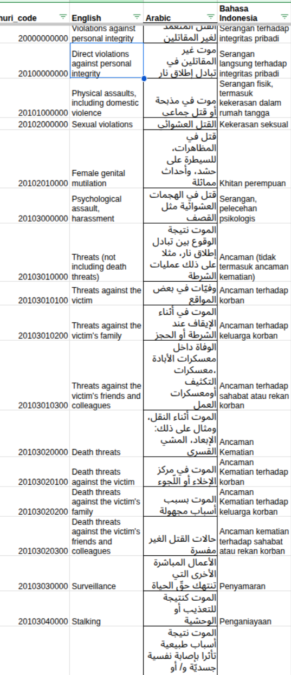
Huridocs
Example: Online Harrassment cases
Microthesauri (vocabulary)
4 - Types of Acts
5 - Methods of Violence

Slide 11
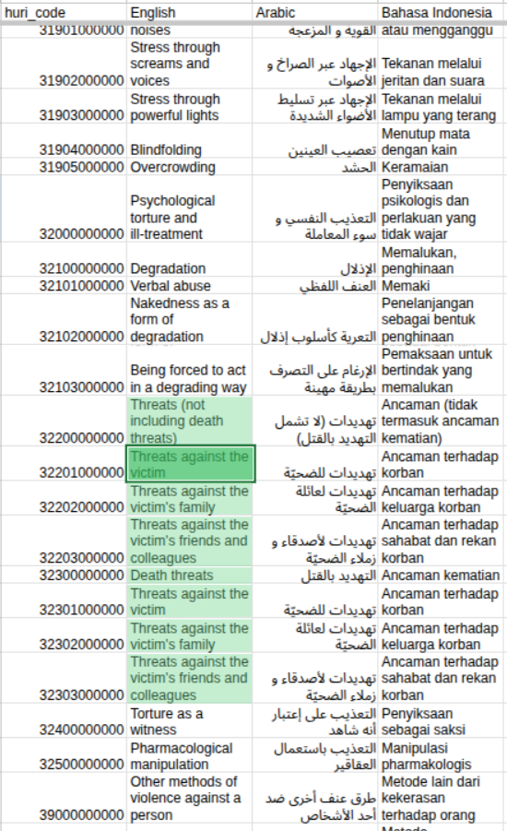
Huridocs
Example: Online Harrassment cases
Microthesauri (vocabulary)
4 - Types of Acts
5 - Methods of Violence

Slide 12
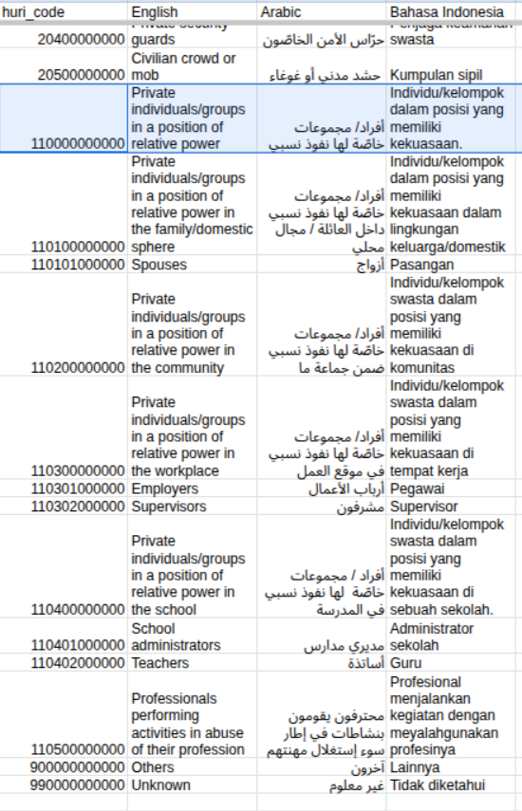
Huridocs
Example: Online Harrassment case
Microthesauri (vocabulary)
24-Types of Perpetrators

Slide 13
Huridocs for researchers/analysts
Microthesauri (vocabulary)
Standardisation for Data Quality and Comparability
Enables Robust Analysis and Reproducibility
Mapping Complex Realities to Structured Data
Notes:
Framework for Documenting Human Rights
Specifically tailored to the nuances of human rights violations, including the legal frameworks
Can be adapted for tech abuse

Slide 14



What is GDELT?
What it is: A Massive, Open-Source, Real-Time Global Event Database
Supported by Google Jigsaw
(News, News reports) Events that already happened (1979-now)
Unlocking Insights: Trends, Patterns, and Causality
How to Get Started
Analysis https://analysis.gdeltproject.org/
Summary https://summary.gdeltproject.org/

Slide 15
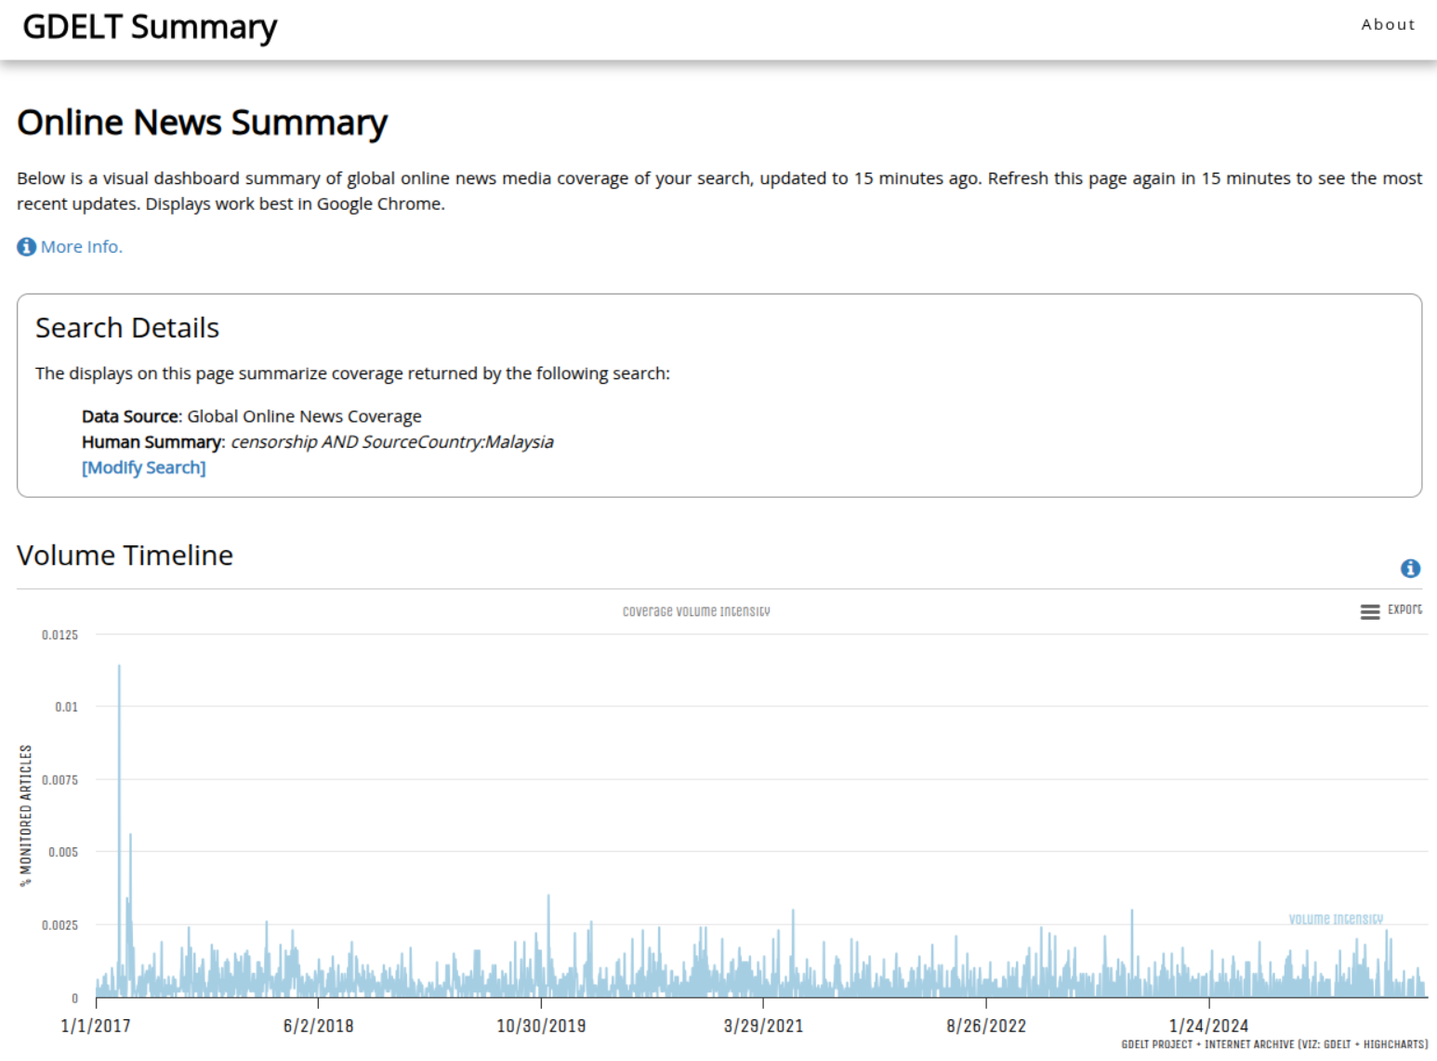
GDELT Summary : Censorship

Slide 16
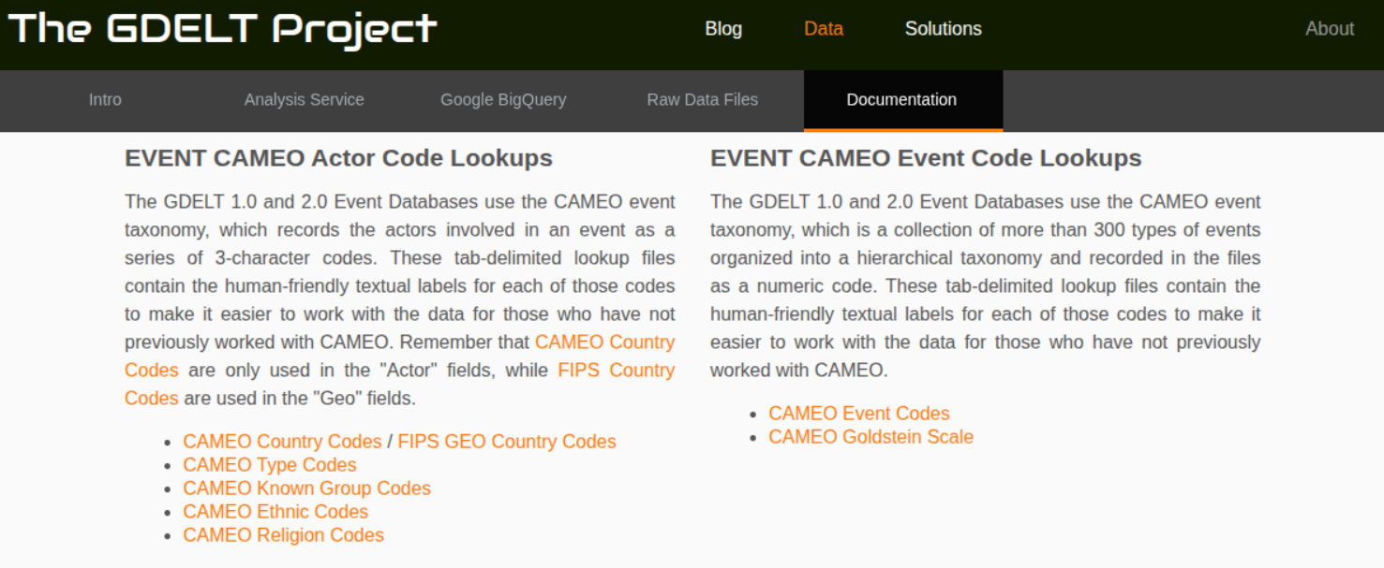
What is GDELT-CAMEO?
CAMEO .
https://www.gdeltproject.org/data.html#documentation
Notes:
Code book for news, reports events to identify macro-level events for quantitative research and trend analysis
Intensity scale - goldstein scale
GDELT 2.0 uses CAMEO taxonomy post 2019 for automation in h.r. event standardisation for trend analysis

Slide 17
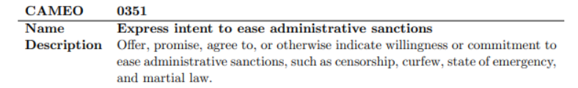
GDELT Summary : Censorship
Notes:
automated coding scheme for news, reports to identify macro-level events for quantitative research and trend analysis.
classifying events into general action and actor types, suitable for automated counting
designed for automated, algorithmic processing of text data.
While humans define the CAMEO codes, the application of those codes in GDELT is machine-driven.

Slide 18
What is GDELT-CAMEO?
Code book for news, reports events to identify macro-level events for quantitative research and trend analysis.
classifying events into general action and actor types, suitable for automated counting
designed for automated, algorithmic processing of text data.
While humans define the CAMEO codes, the application of those codes in GDELT is machine-driven.
Getting started: Wayback Machine - CAMEO Manual

Slide 19


Standardisation - do once, impact many
Excel/Google Sheets?

Slide 20
Standardisation - do once, impact many

Slide 21

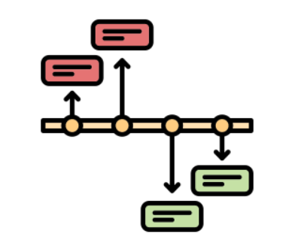
Documenting with Bayanat

Slide 22
Documenting with Bayanat
Open Source Data Management Solution for Human Rights Documentation
Bayanat simplifies the process by providing an easy to use interface, with powerful collaborative team features, advanced search, revision control and more
How to Get Started
Bayanat by SJAC https://bayanat.org/
Bayanat https://bayanat.sinarproject.org/

Slide 23
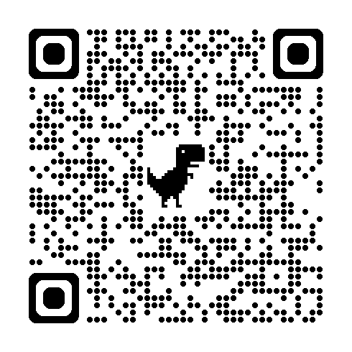
Documenting with Bayanat
Exploratory - Did a POC last month (9th May)
Workflow: Labels feature
Collab: Import & Export Feature
Having a Knowledge Sharing session on “Introduction to Bayanat” this Friday afternoon (3pm)
https://forms.gle/WdbzkzxLrGYfDkwD8

Slide 24
Recommendations
Use Huridocs ESF & Microthesauri as a reference framework for HR documentation but extend it for tech abuse
Micro view - Streamline data with shared language
Extend for Tech Abuse such as AI (Inclusion of MIT AI Risk Repository?)
Refer to GDELT CAMEO for machine learning/automation for research & etc
Macro view - Automated Trend Identification
Any questions?

